Slide 1
My Erasmus Trip to Spain
by Daniel Makhnach

Slide 2
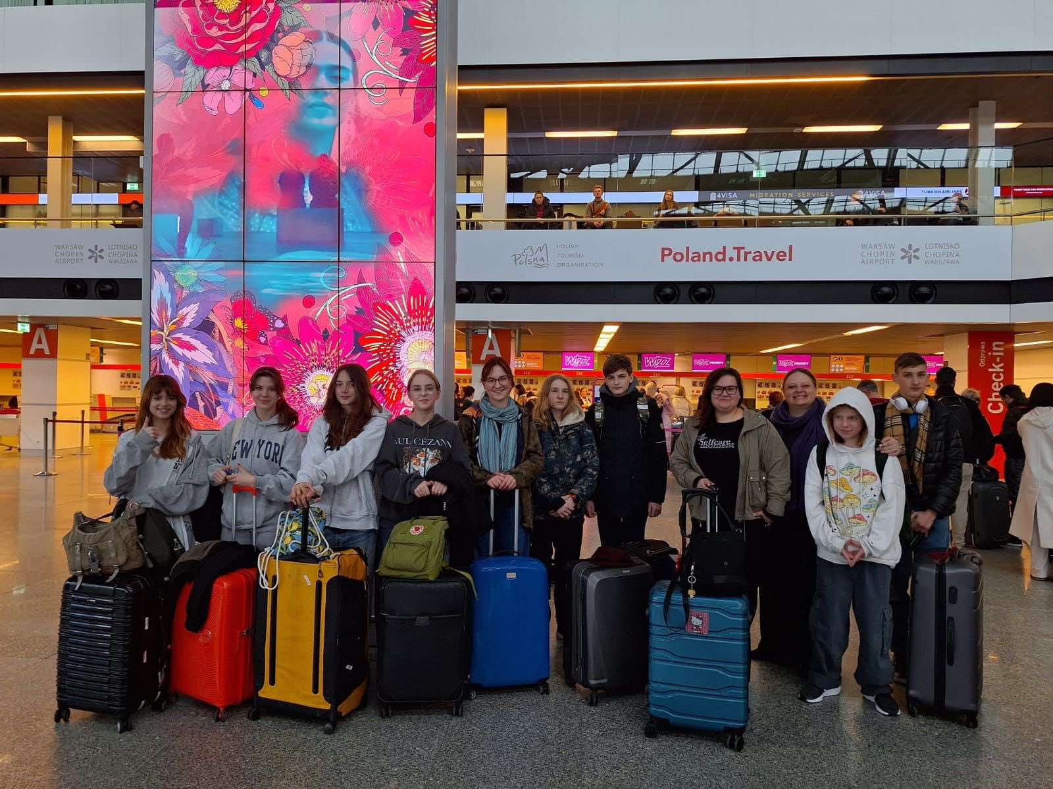
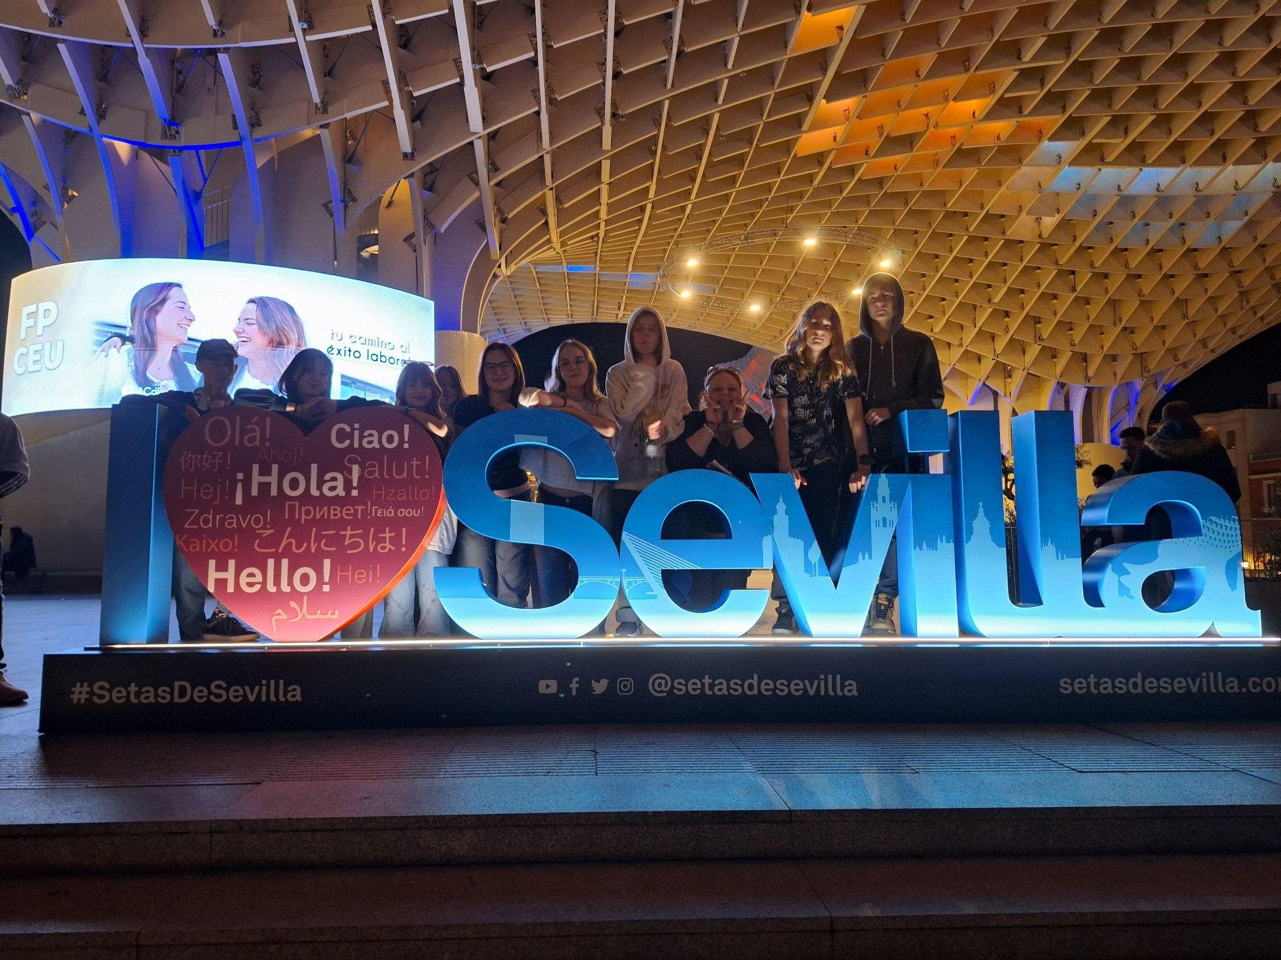
Day 1: February 17th Warsaw - Sevilla

Slide 3
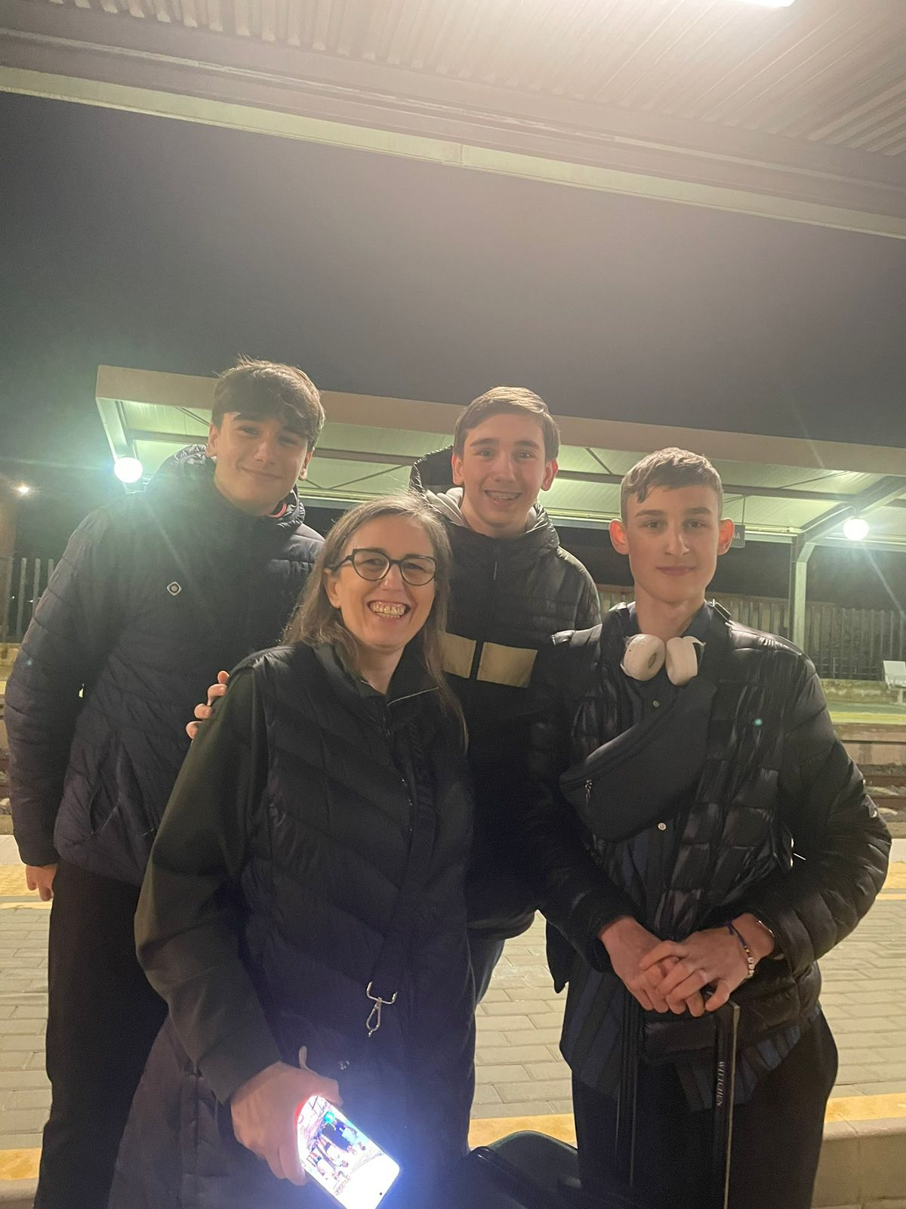
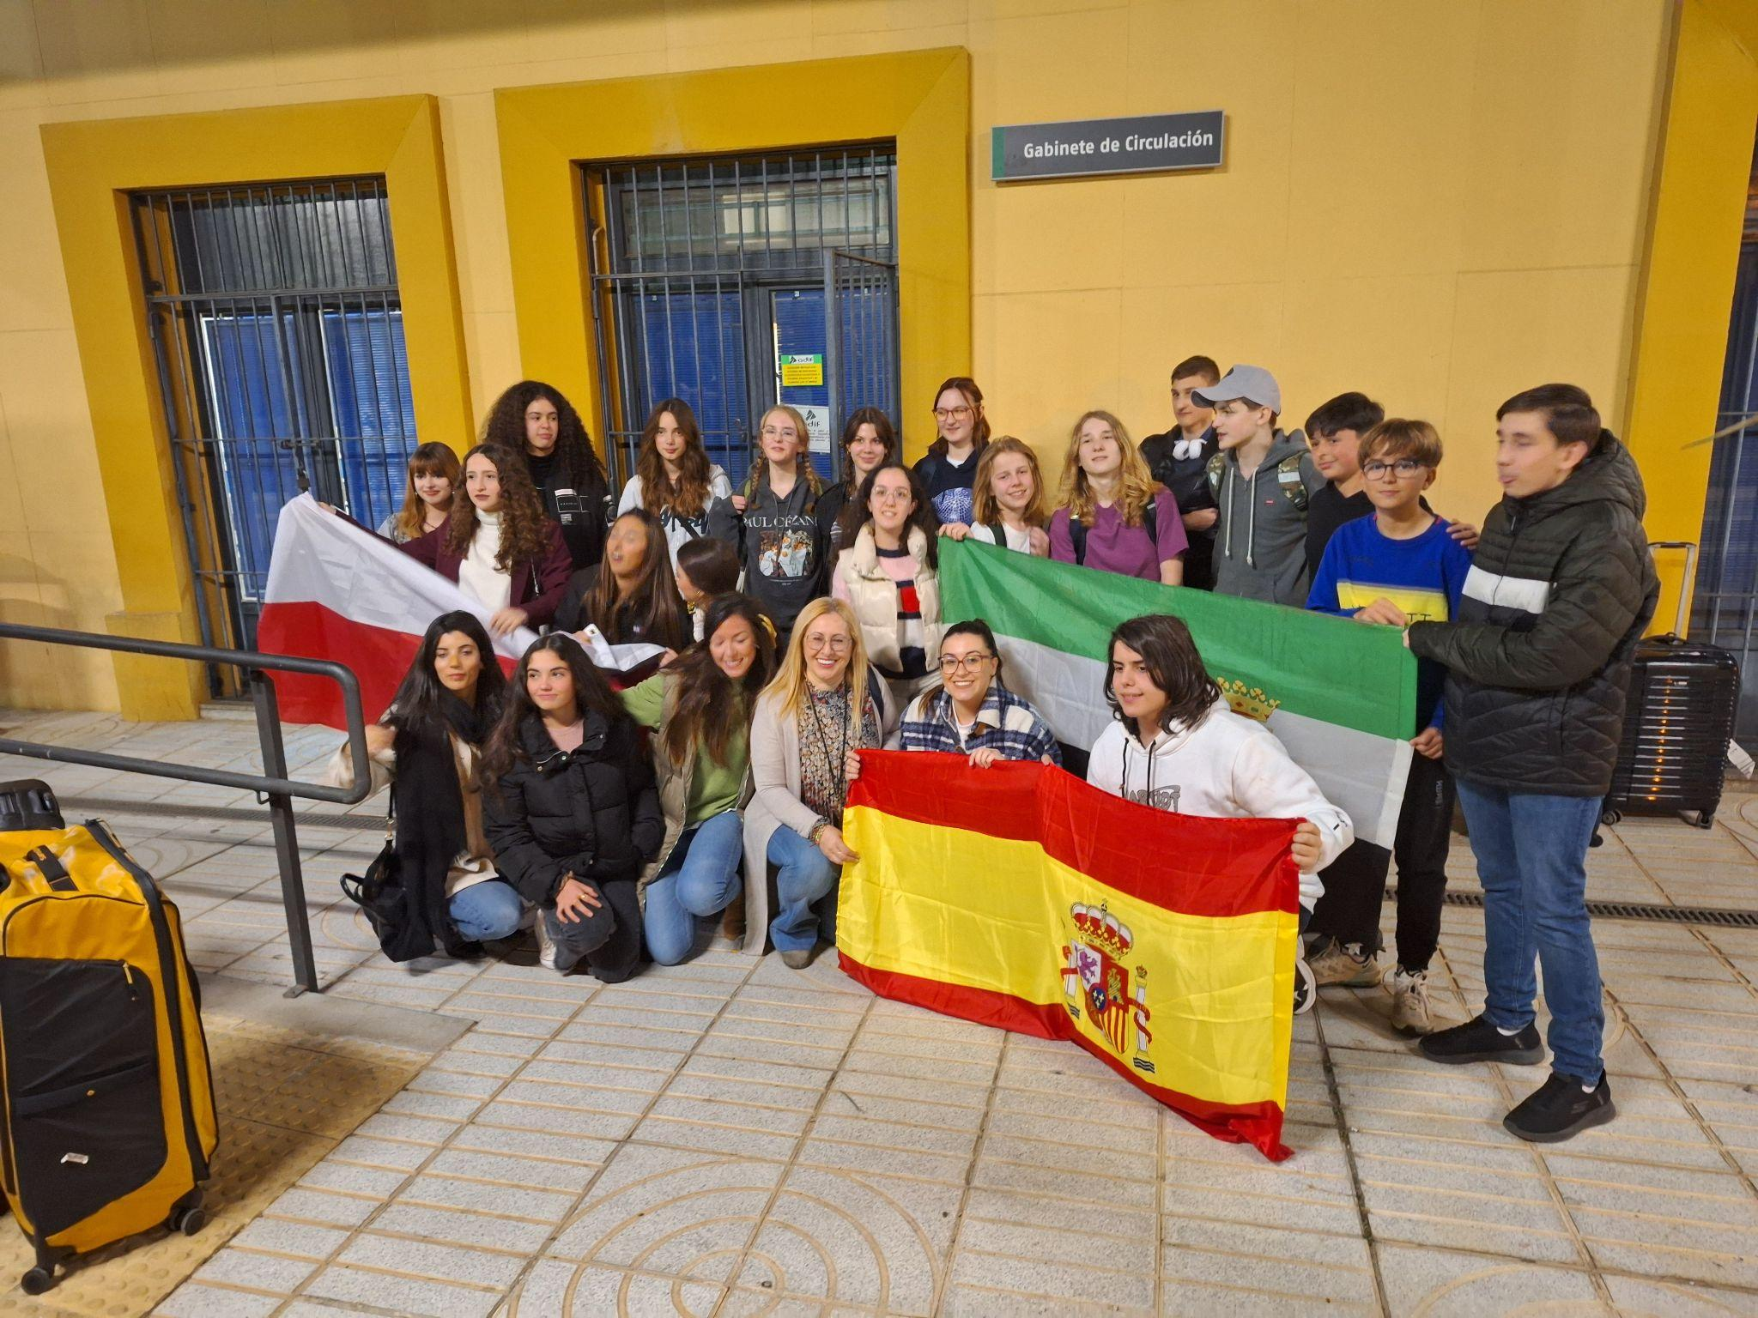
Day 2: February 18th Sevilla - Villanueva de la Serena
my host family

Slide 4
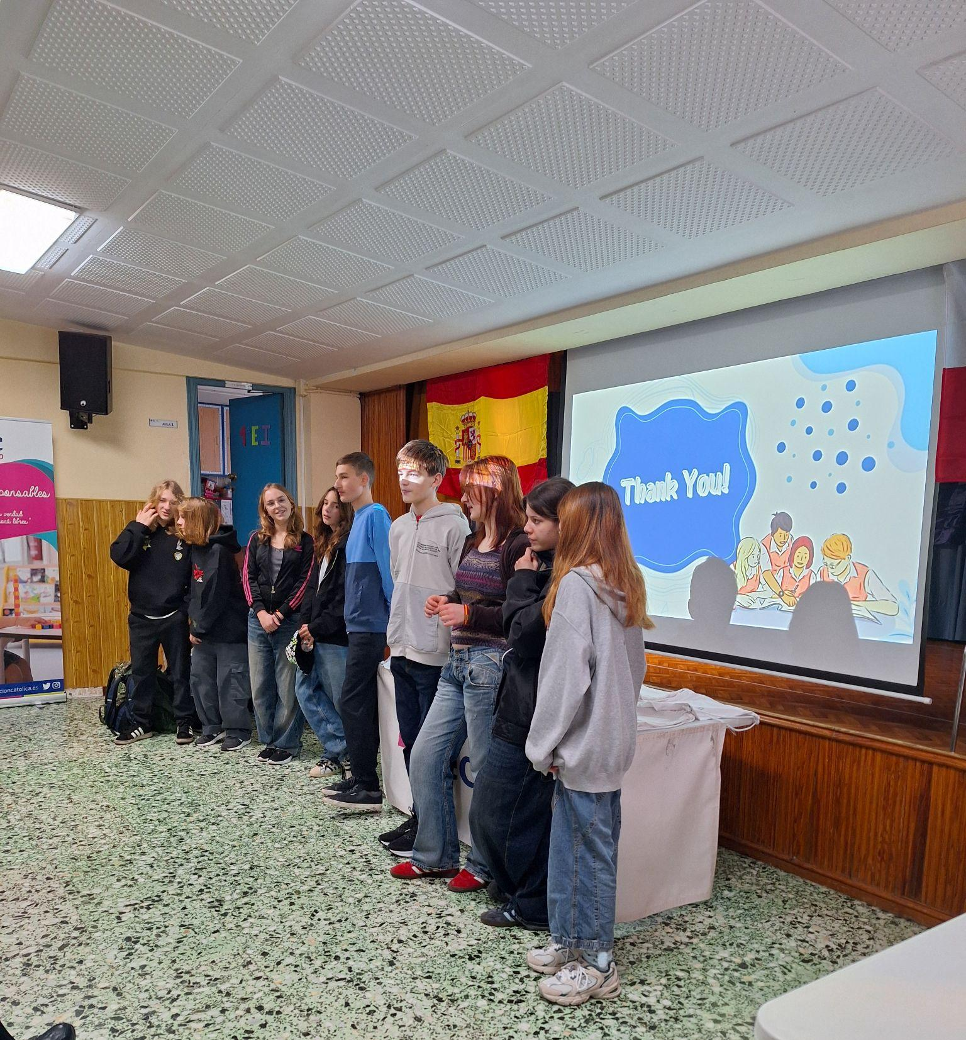
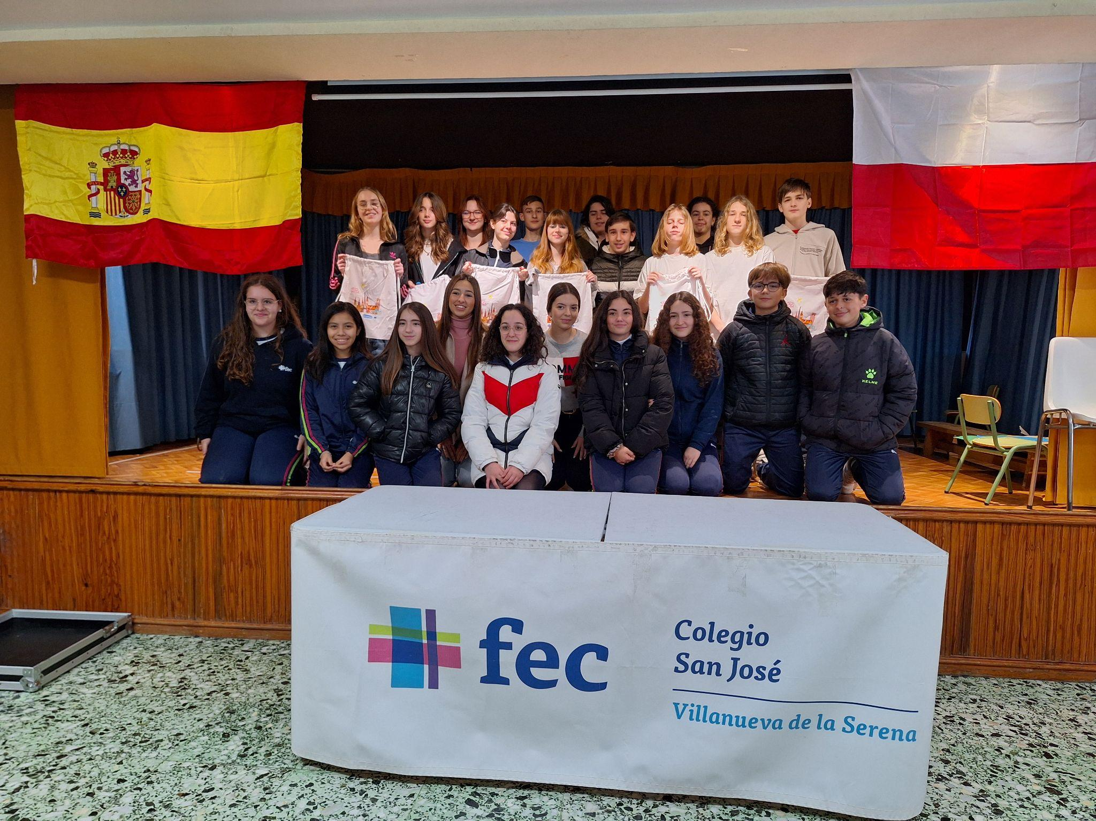
Day 3: February 19th - First day at FEC San Jose Villanueva de la Serena

Slide 5
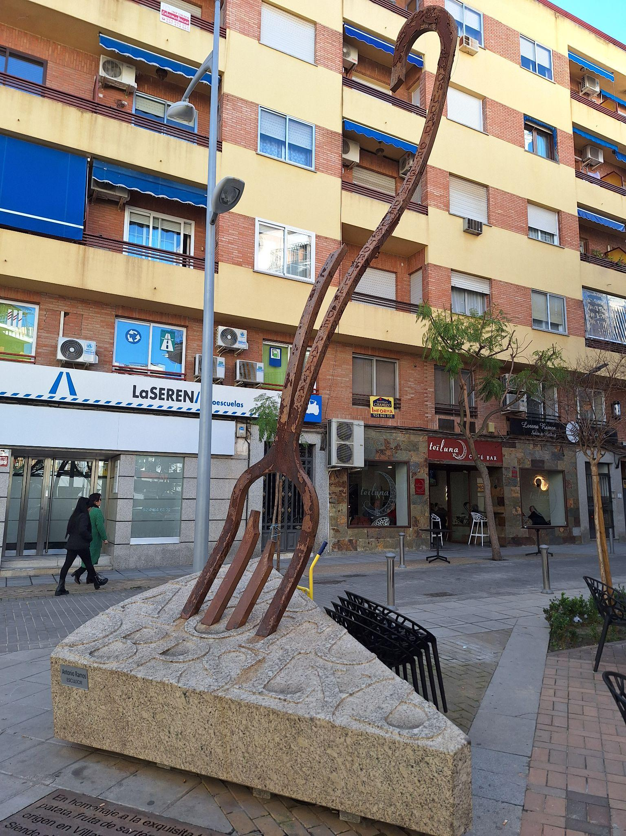
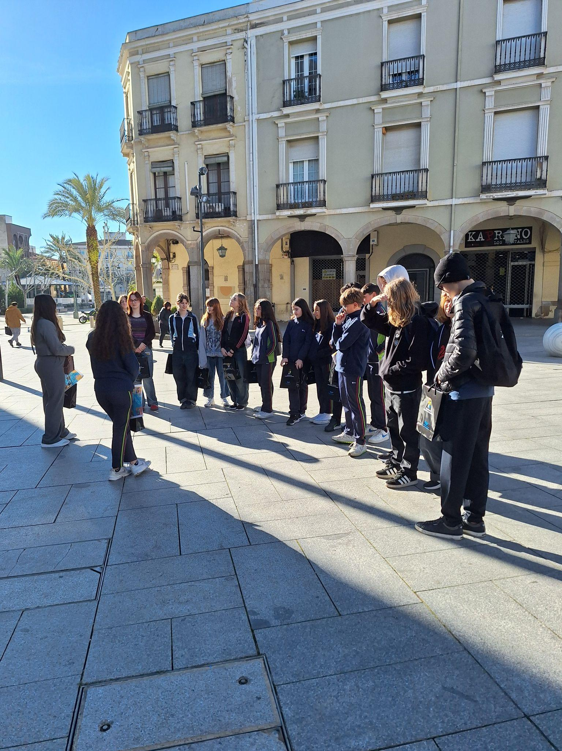
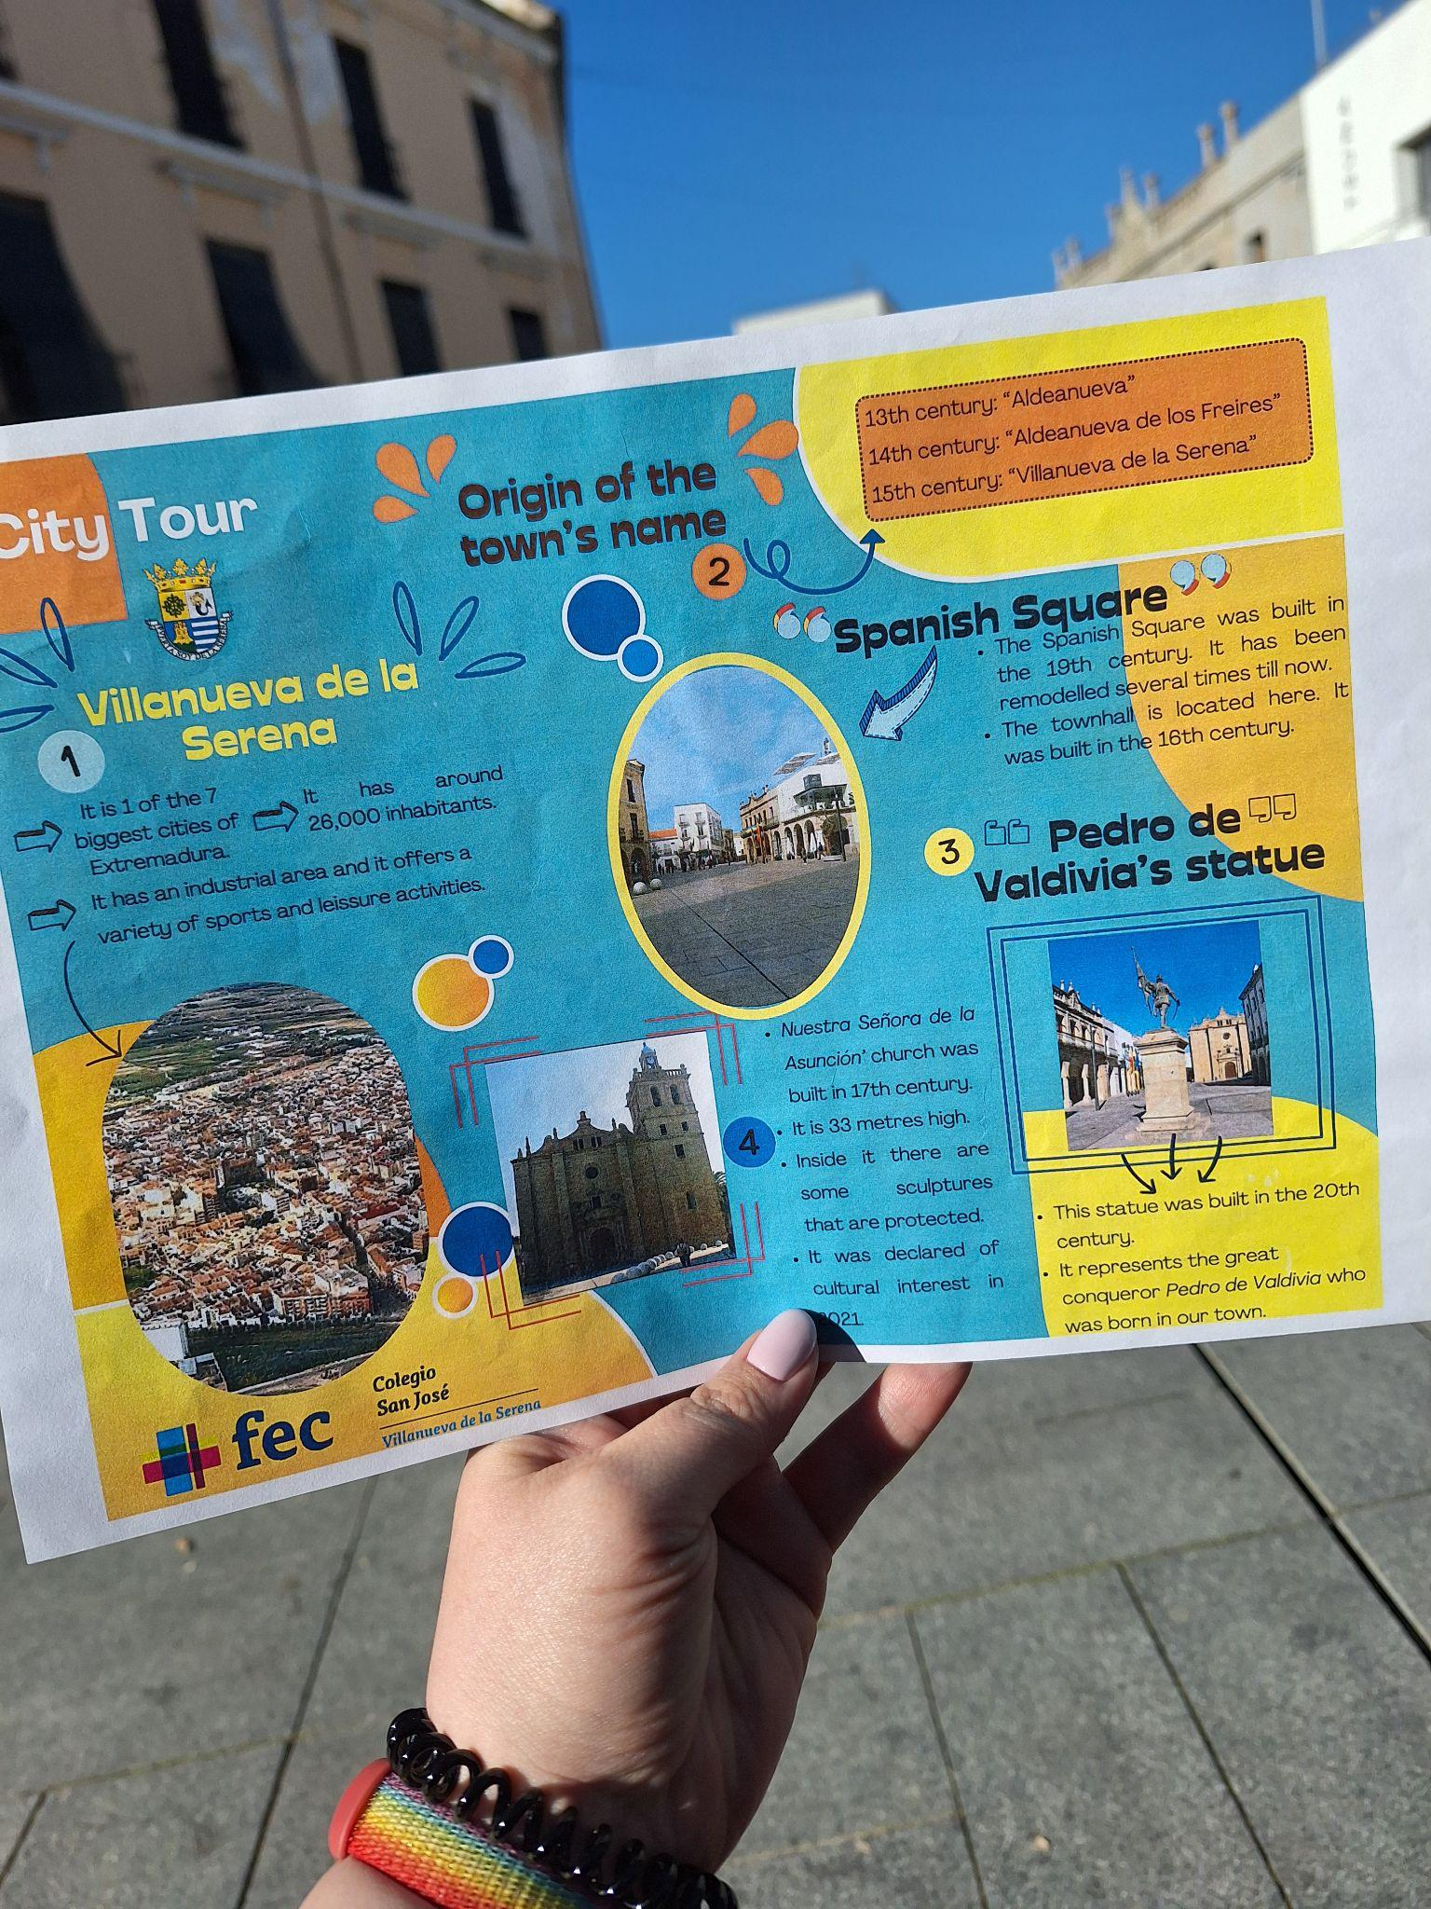
… and exploring Villanueva de la Serena on foot
The town was small but really charming. I loved the tour and the places we visited.

Slide 6
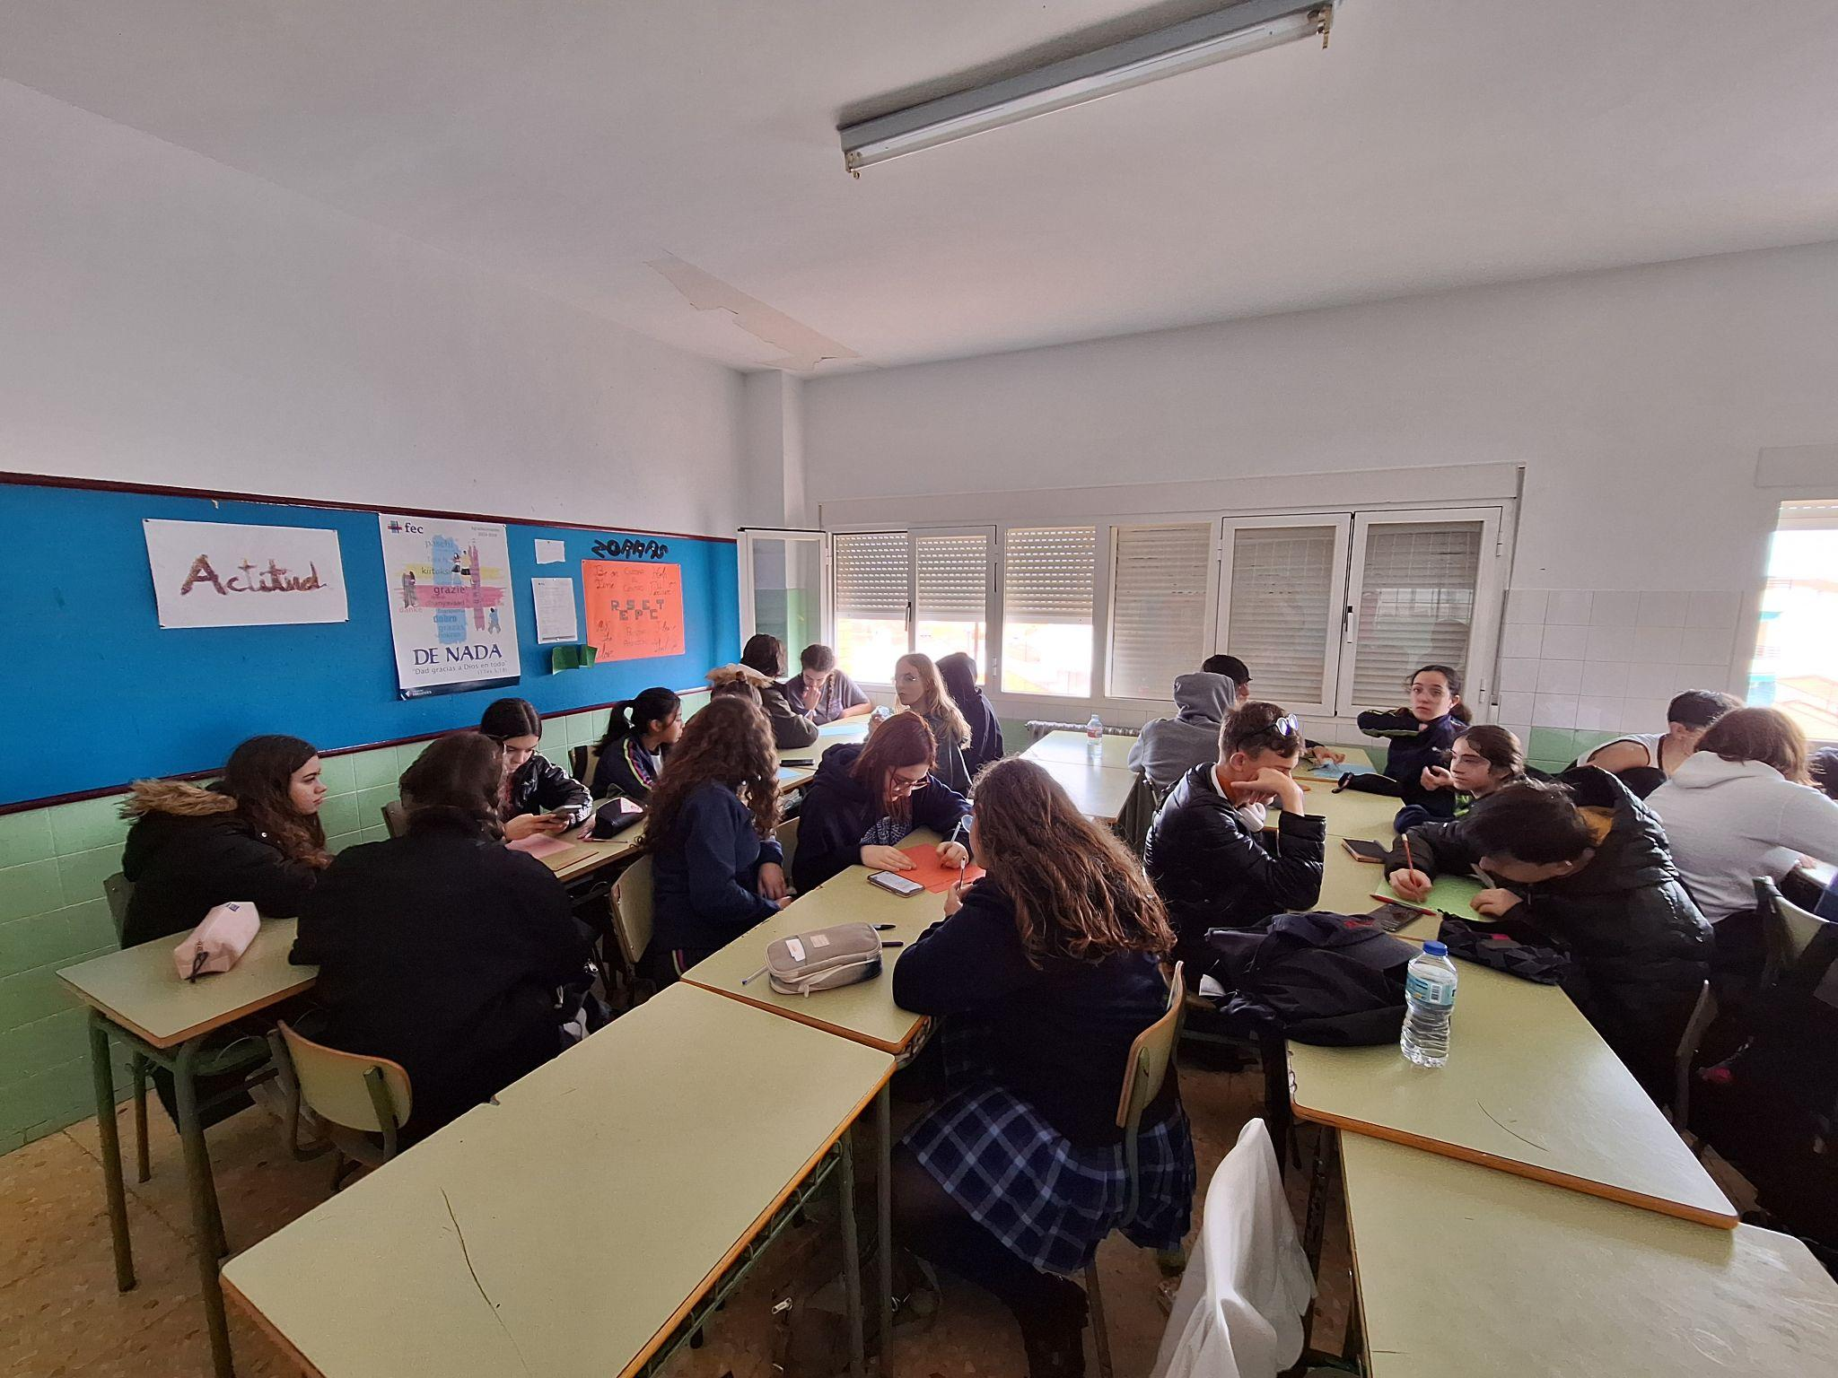
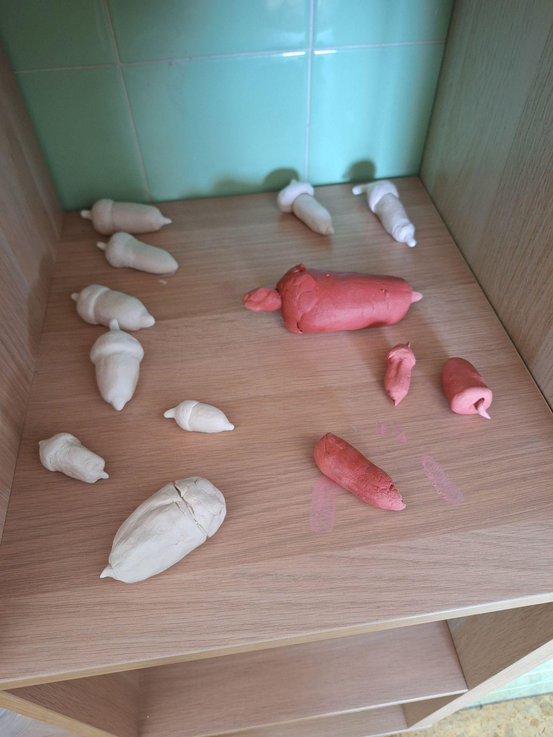
Day 4: February 20th - Getting to know FEC San Jose and its students
On that day we did some fun activities, like making acorns from clay:-)

Slide 7
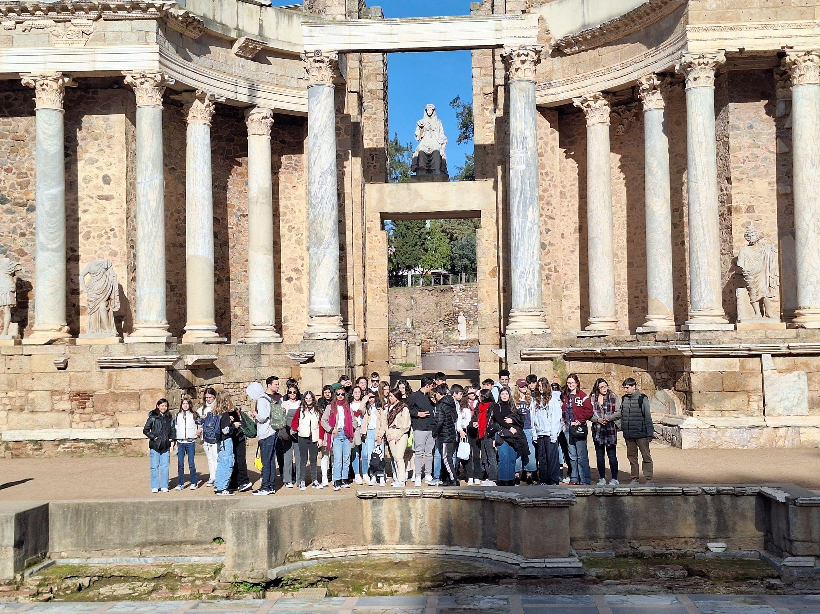
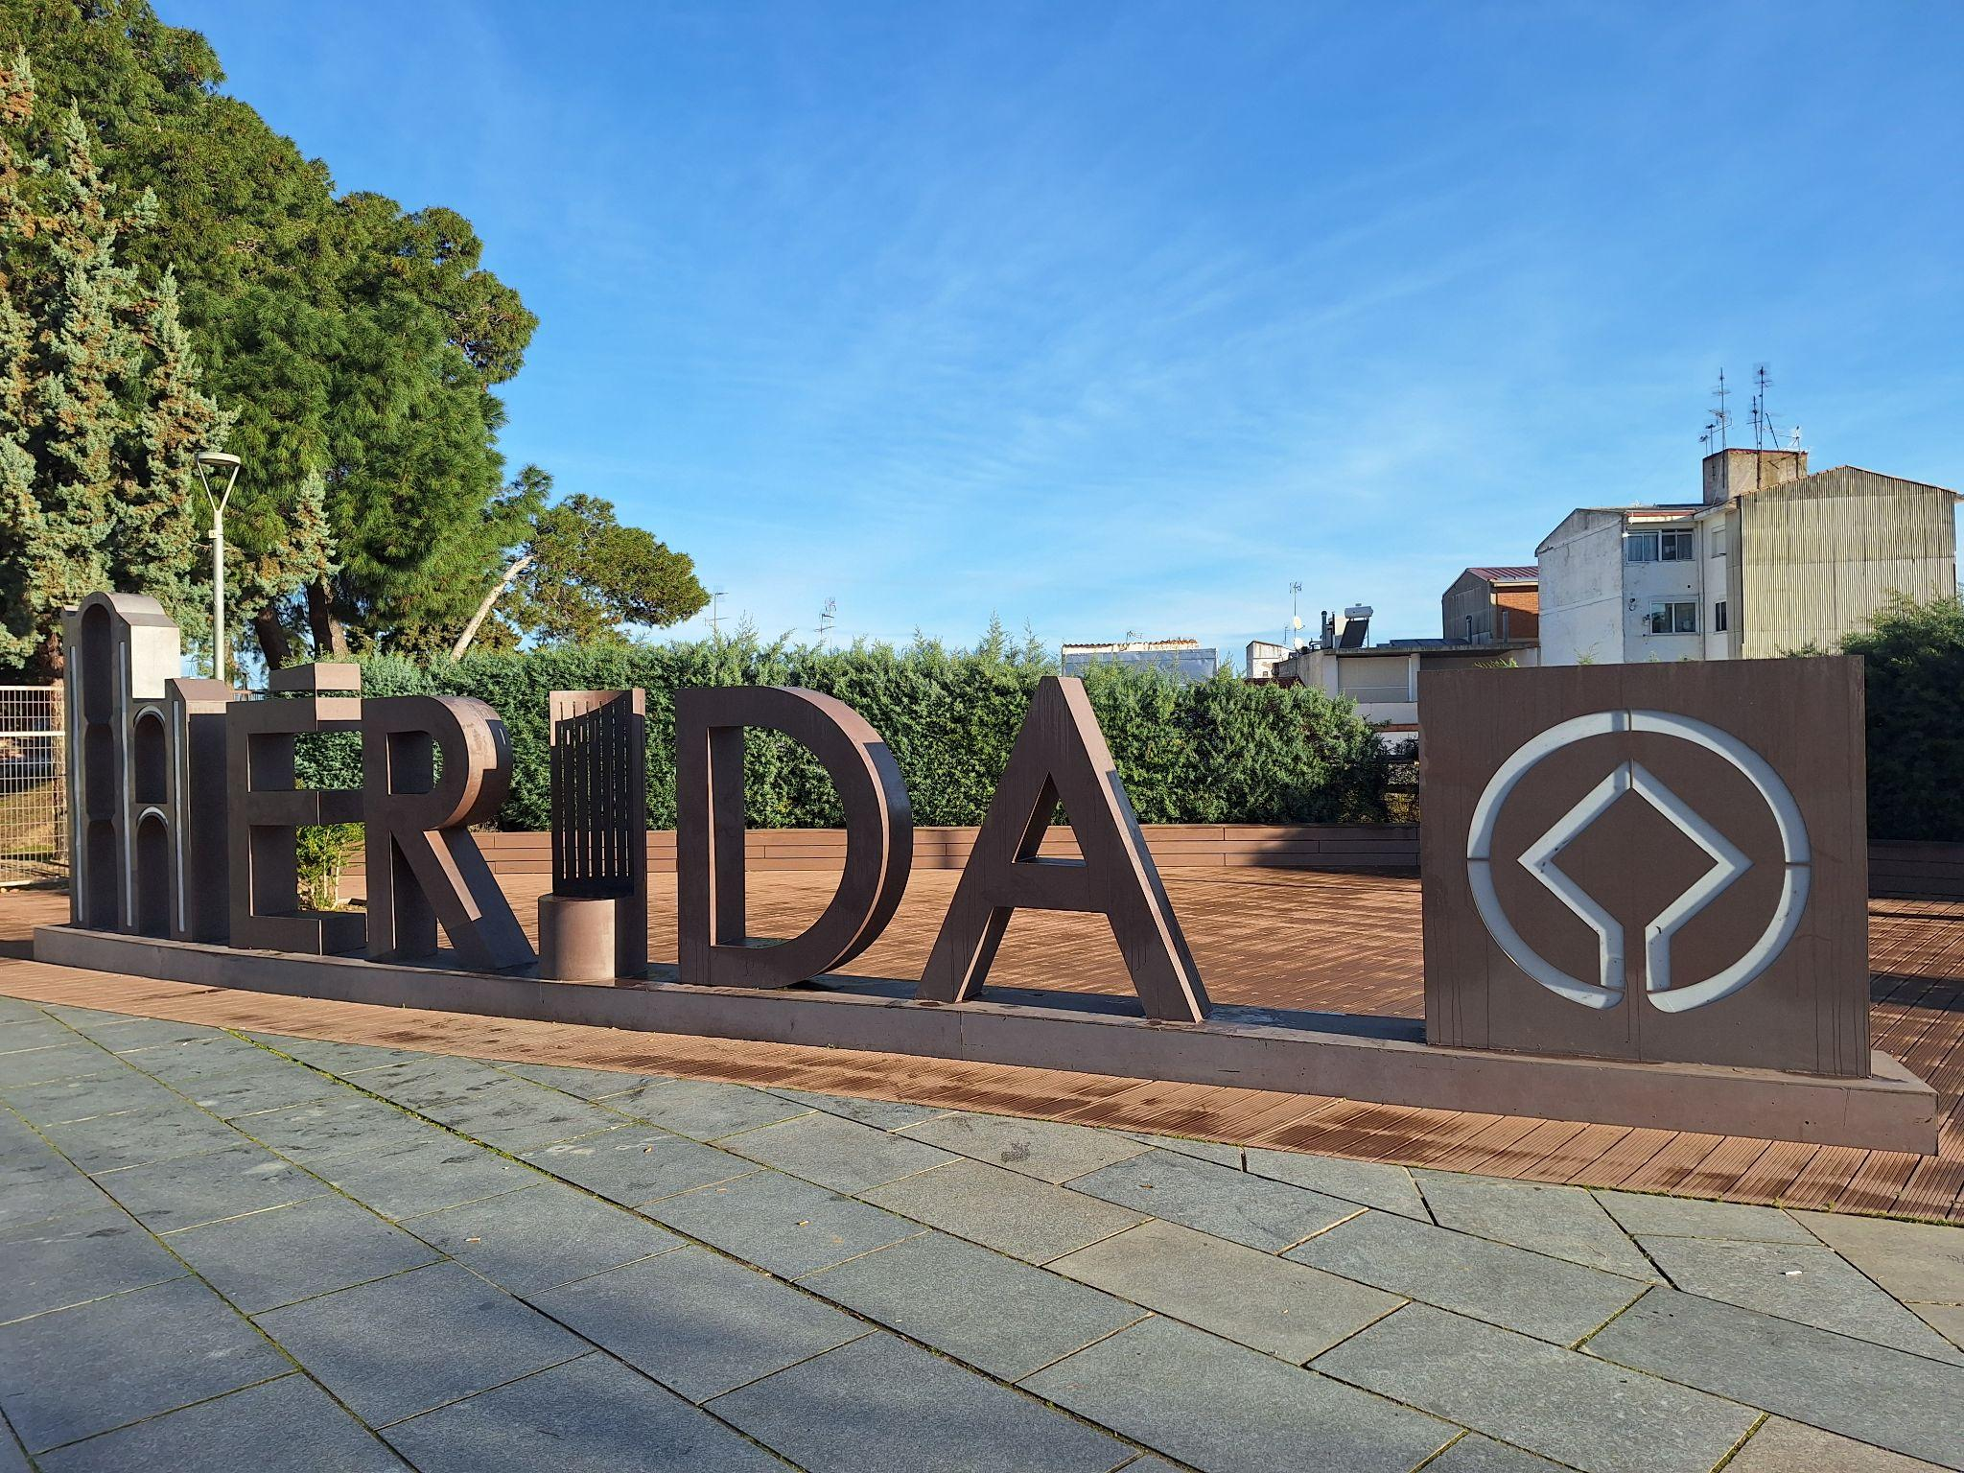
Day 5: February 21st - trip to Merida
Being a fan of ancient history, I really enjoyed the beauty of this historical town, which is home to dozens of Roman ruins.

Slide 8
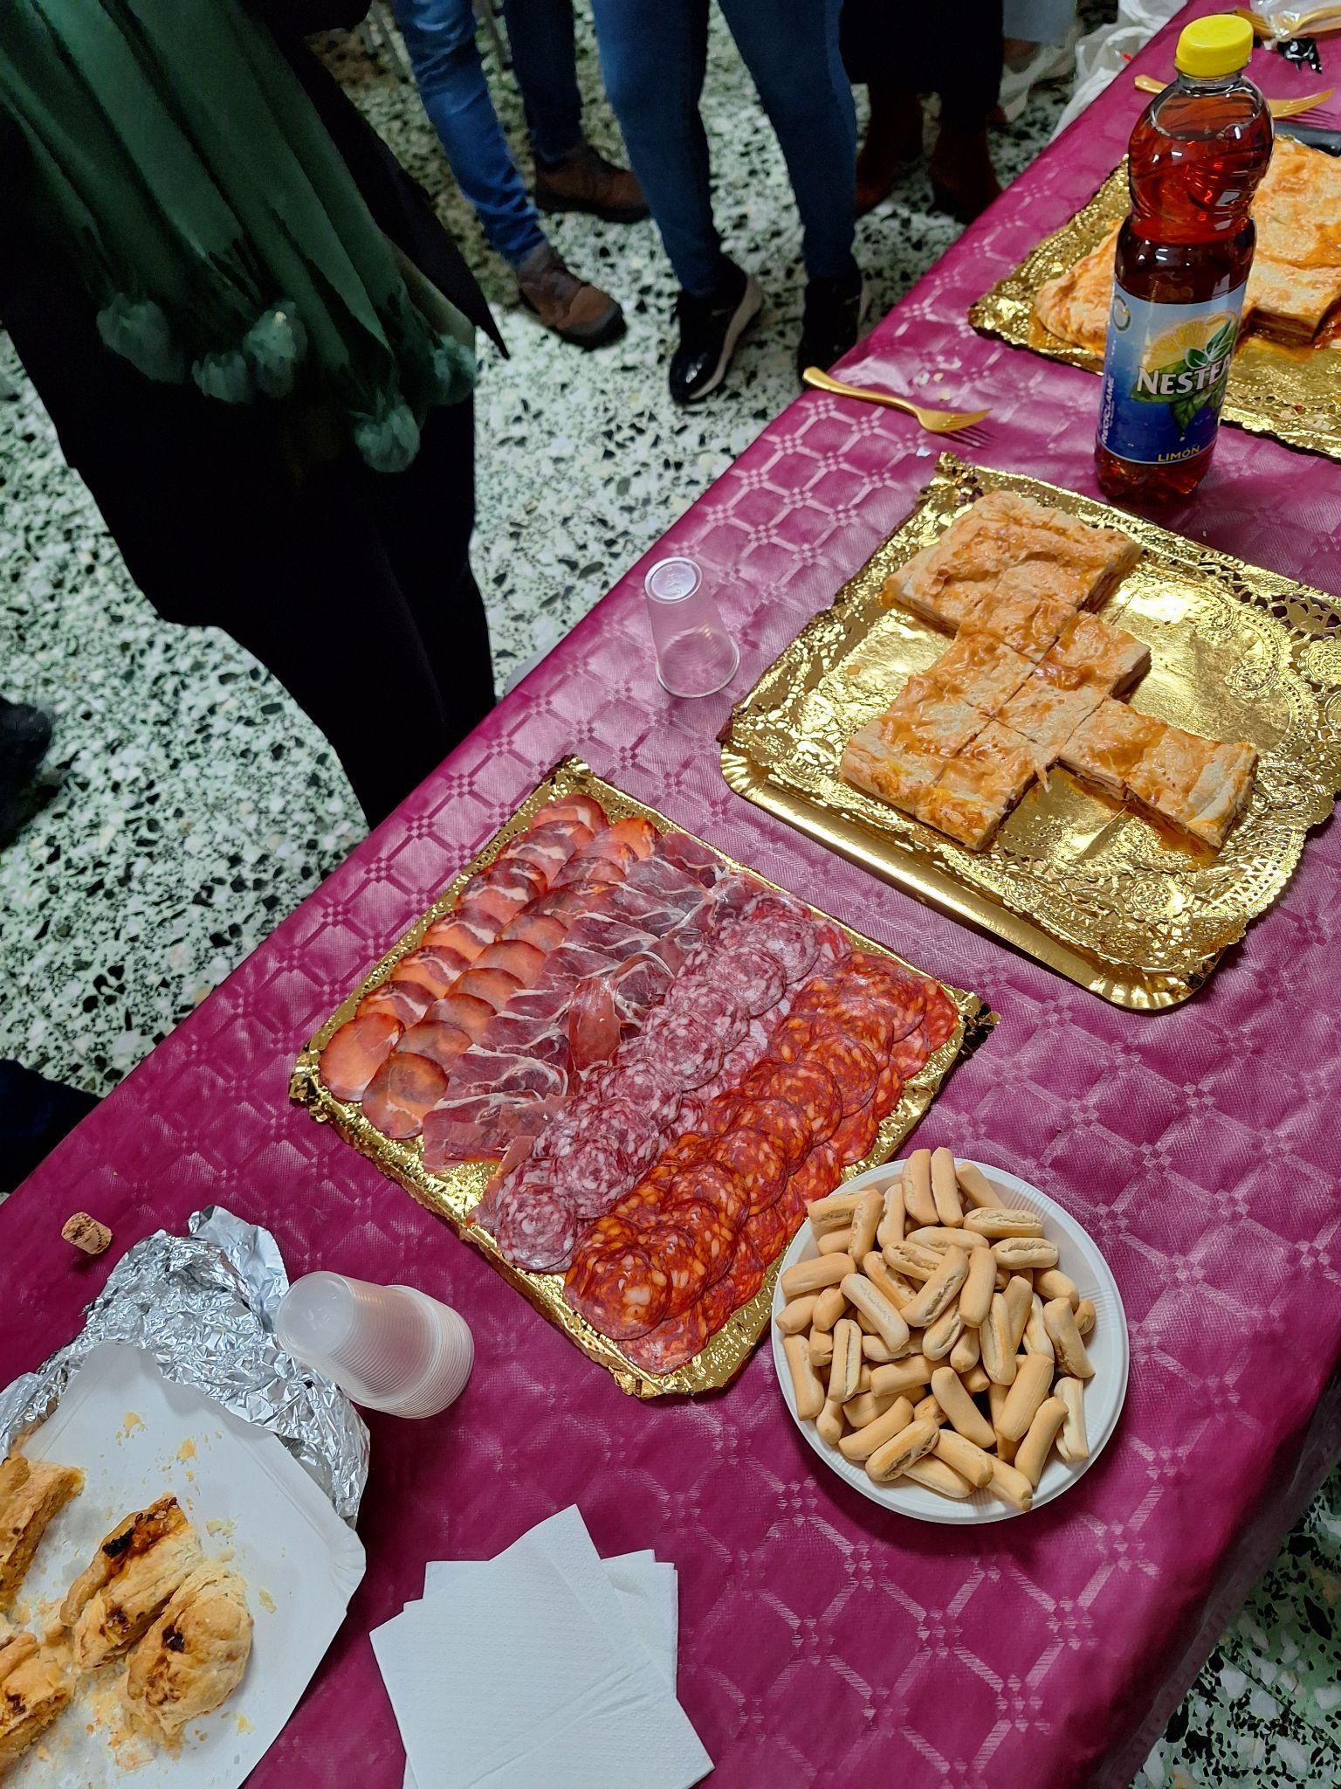
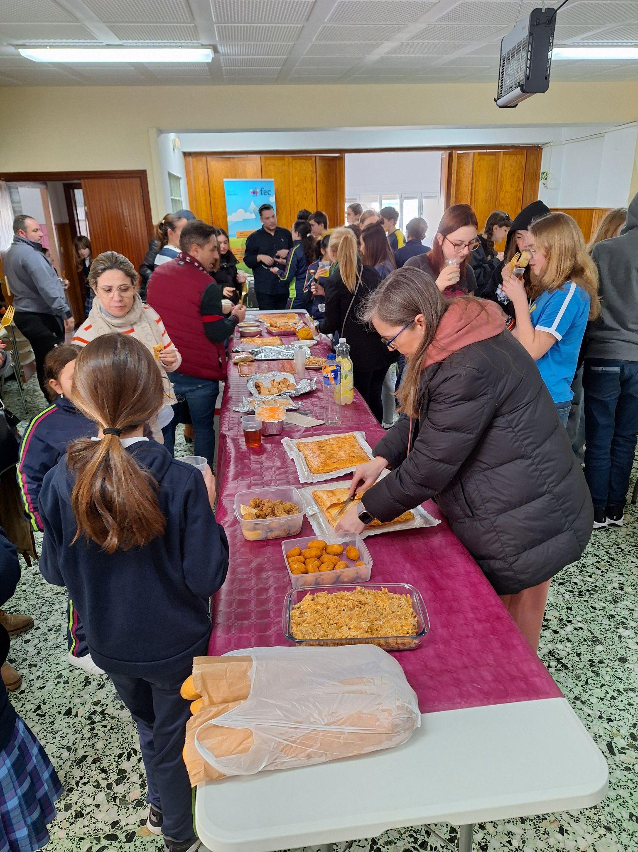
Day 6: February 22nd - Spanish feast
Host families prepared some delicious local specialities for us to taste.

Slide 9
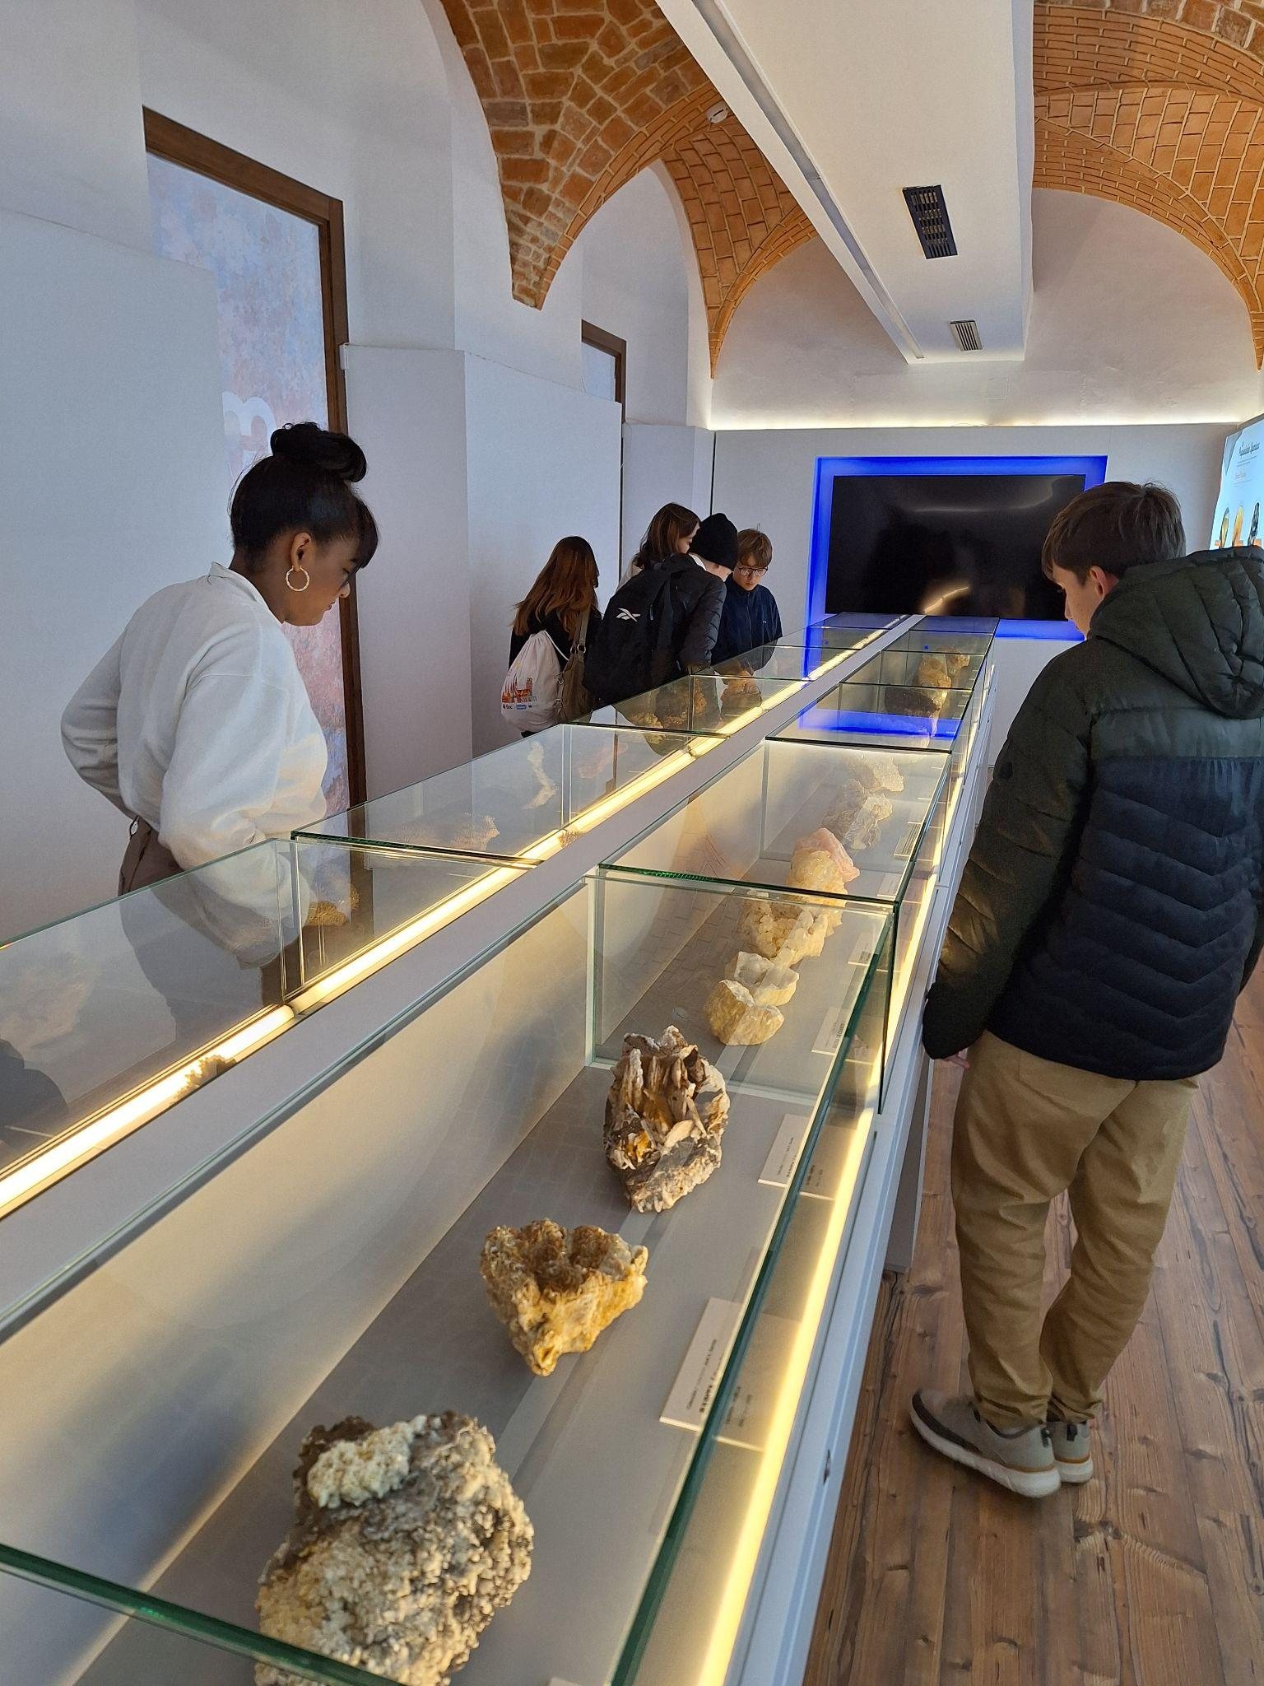
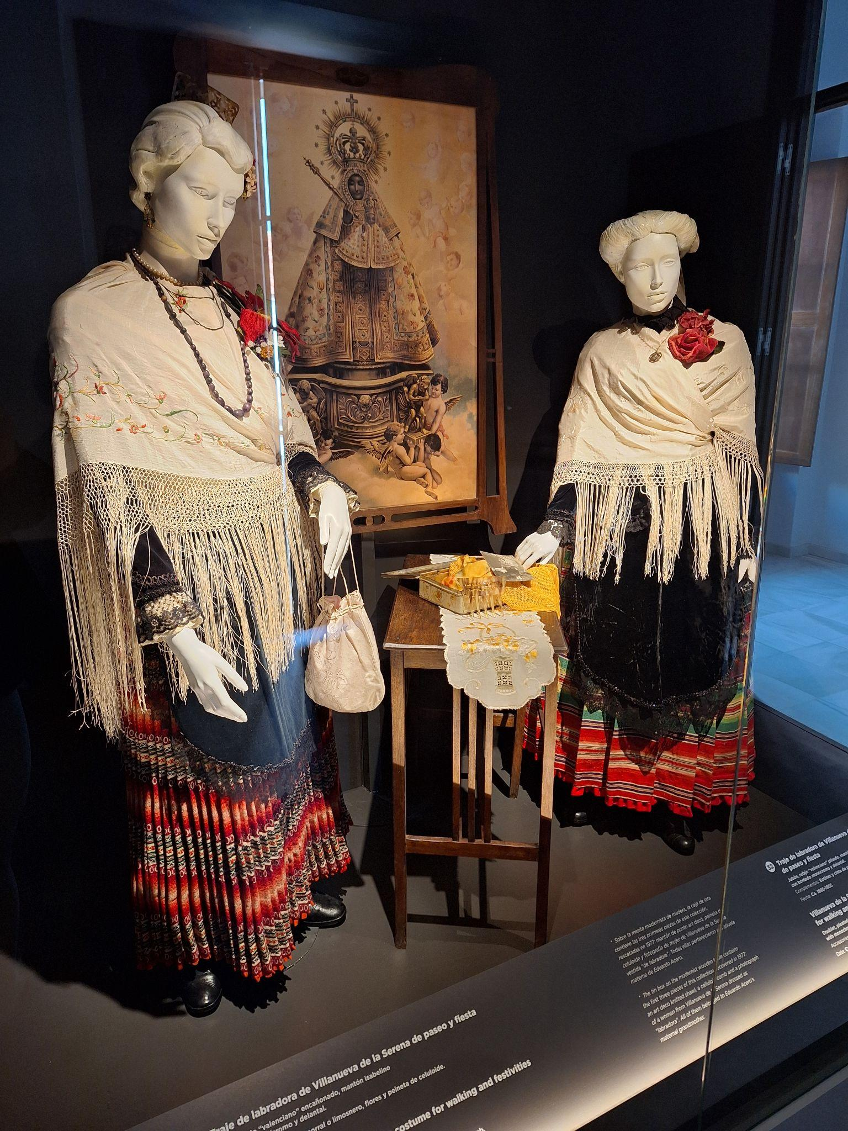
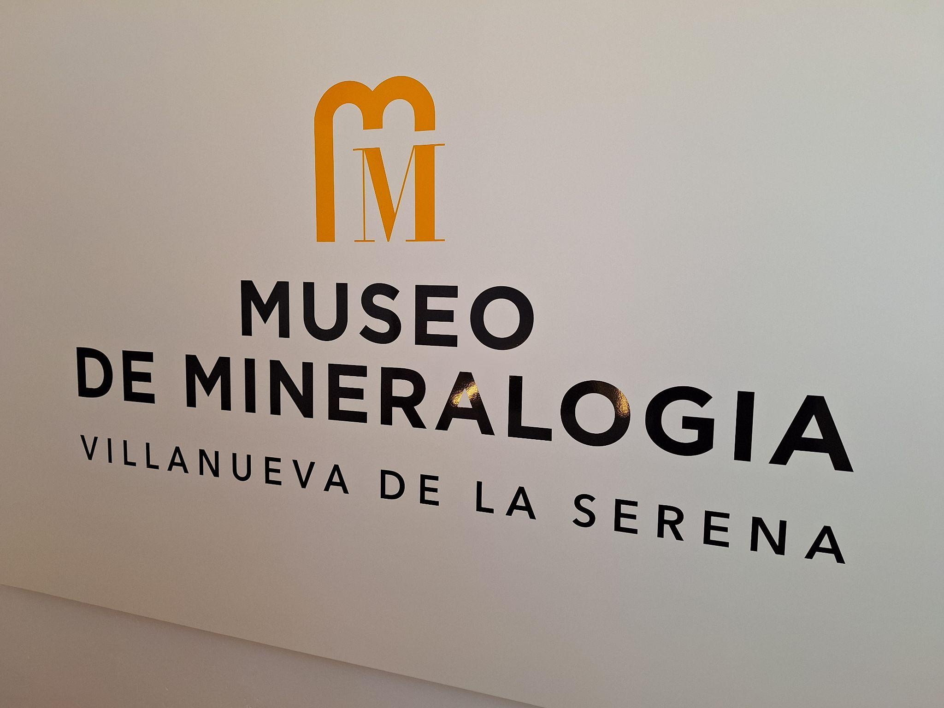
Day 7: February 23rd - Visit to the Mineralogical Museum

Slide 10
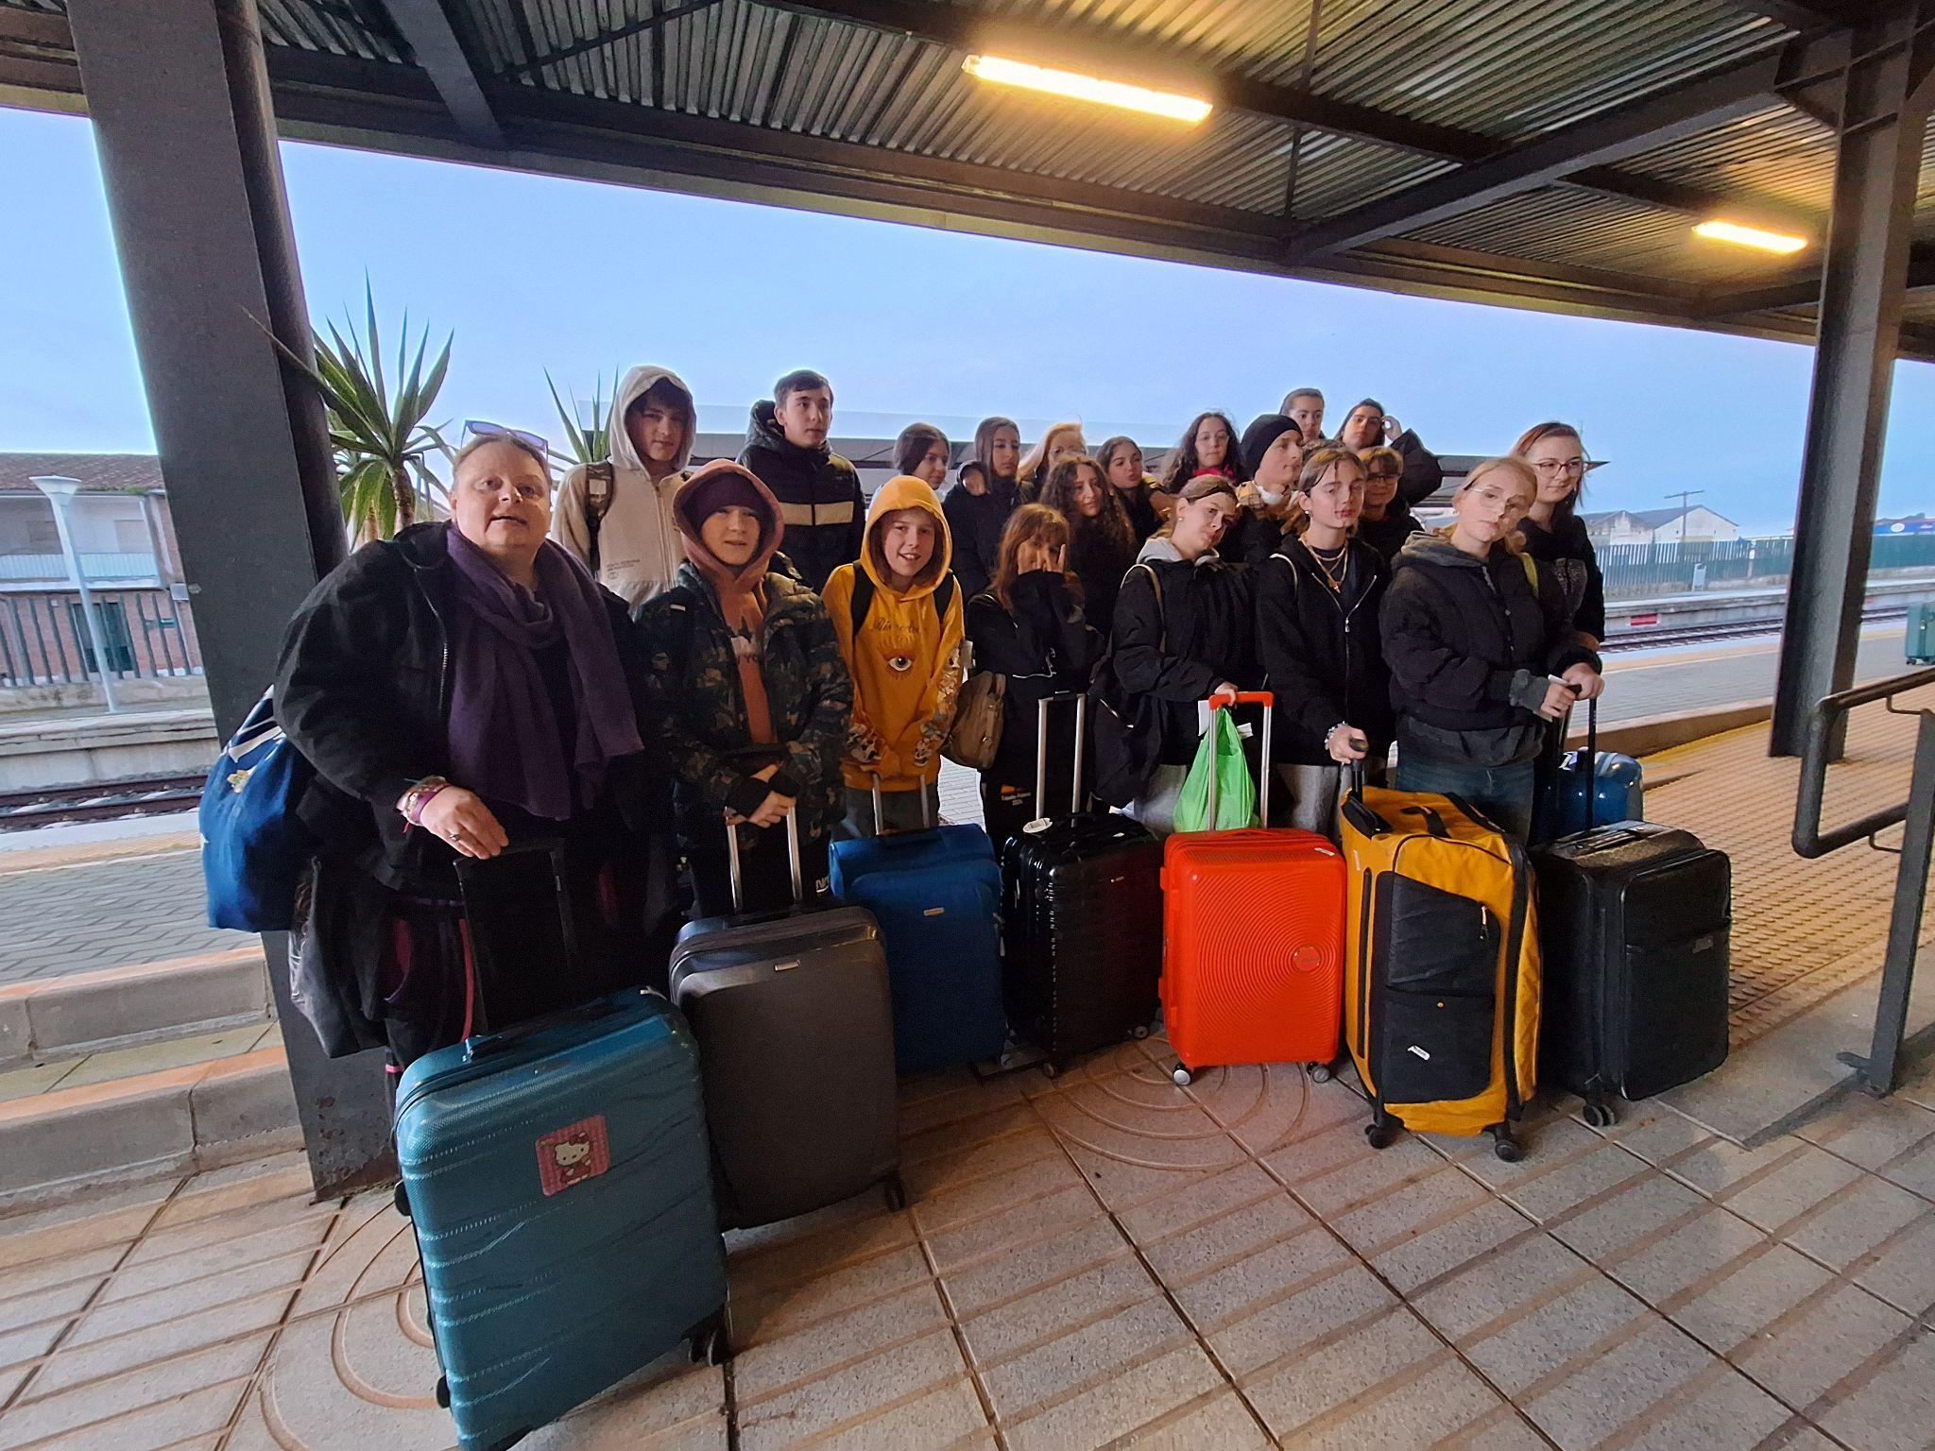
Day 8: February 24th - Time to say goodbye :-(

Slide 11
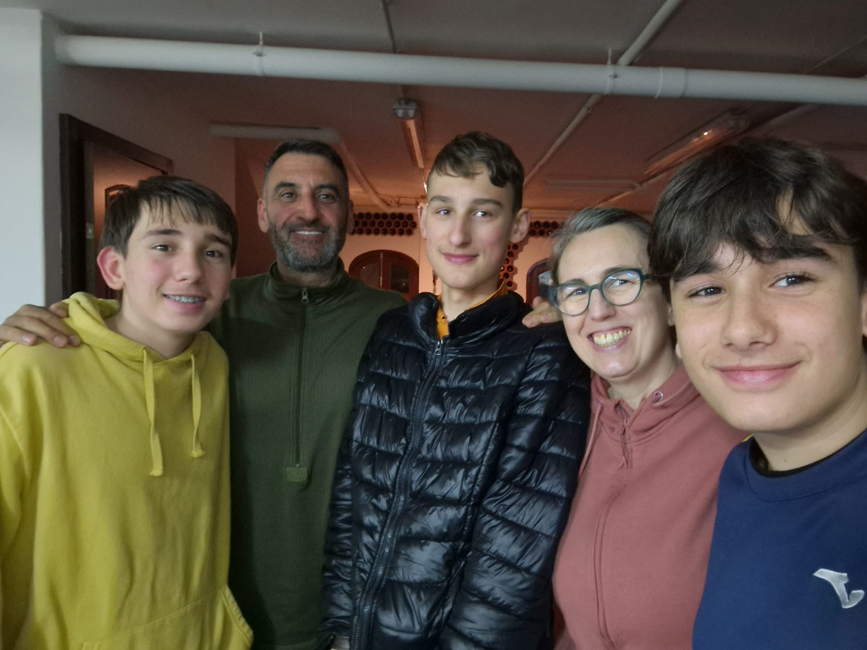
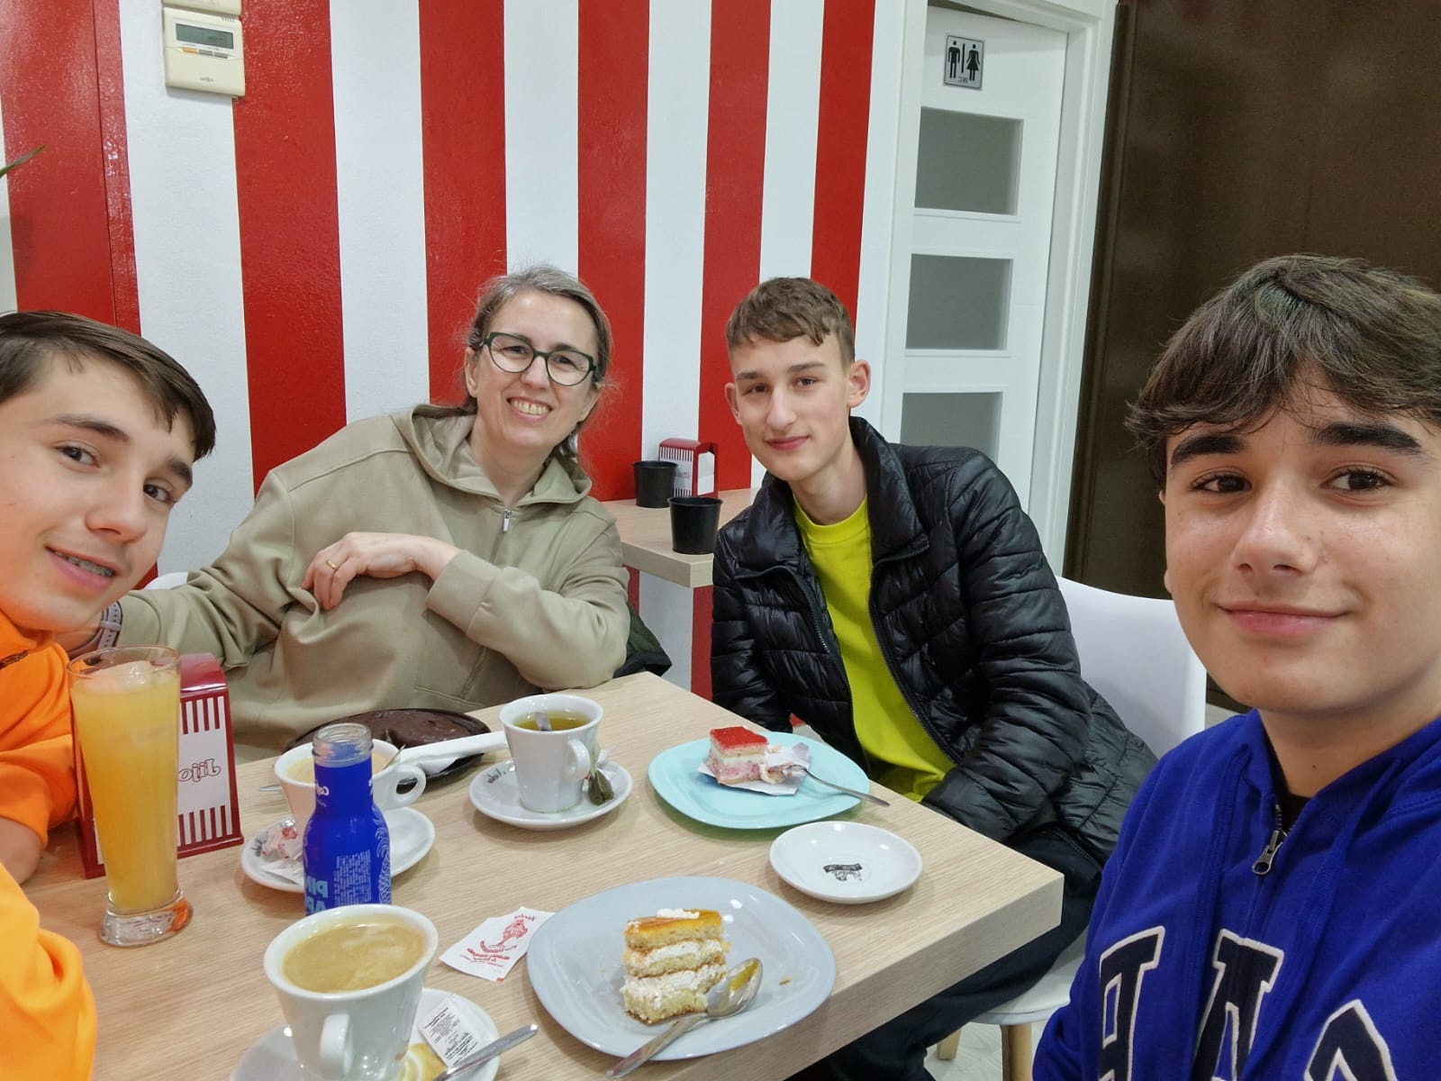
MY SUPER HOST FAMILY
I’m really grateful to them for making me feel at home:-)

Slide 12
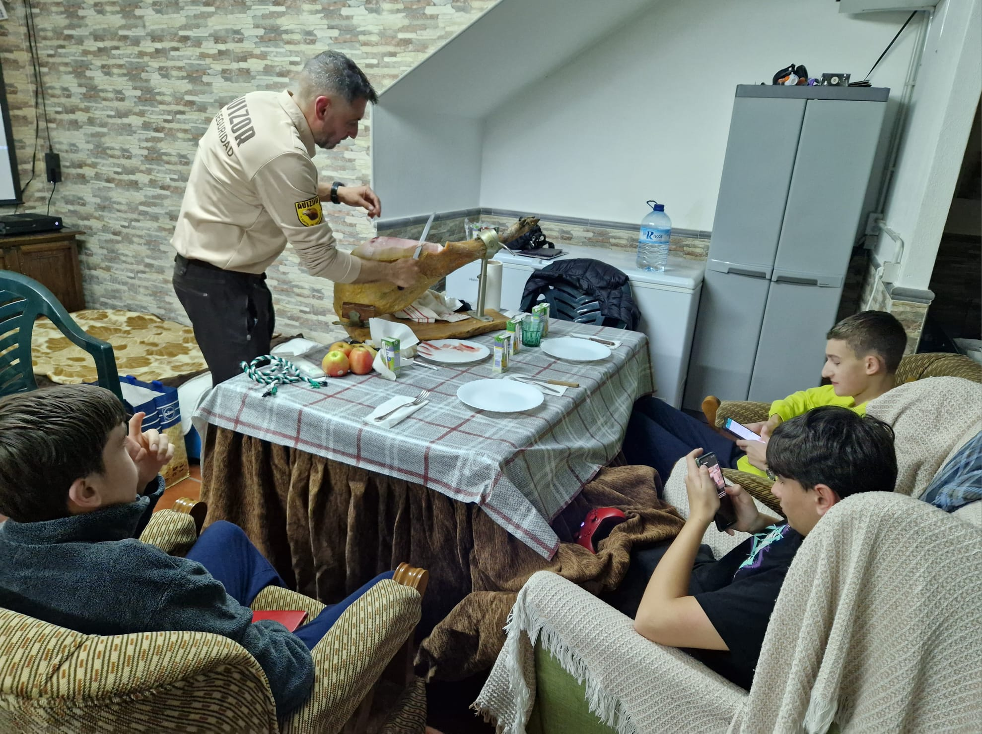
MY SUPER HOST FAMILY
I have never eaten so much jamon in my life; and now I REALLY LOVE it!!!

